Slide 1

Lab 3: i/O & POSTNET
CSE 2301 – Fall 2024

Slide 2

Weekly News From prof. Maifi Khan
This is a two-week lab
Labs and lab demos will be held entirely in ITE C31. We will not hold online office hours except in circumstances where the student has clearly communicated with TAs about such a need.
The first part of this lab assignment (details in this week’s scoring rubric) will be due next Thursday/Friday, as usual.

Slide 3
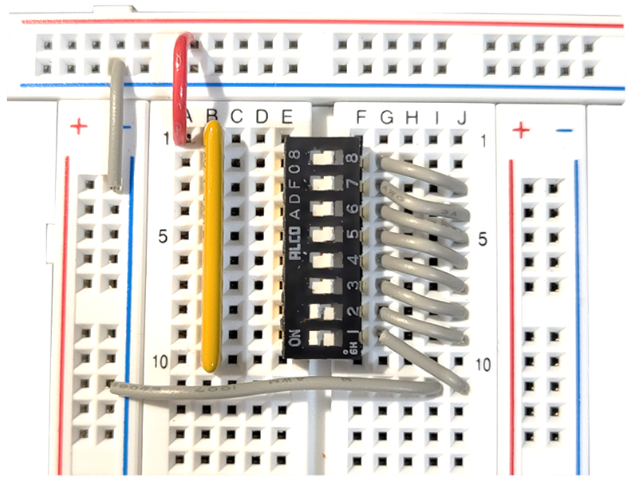
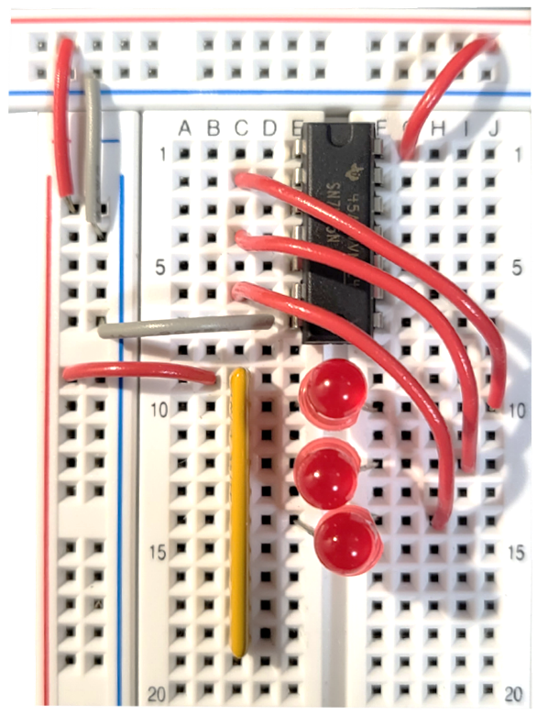
Introduction: BUILDING Input and output
The input and output hardware will be used for the entire semester. These circuits are necessary for both generating signals and, obviously, showing results.
You will not be dismantling your hardware at the conclusion of this part of the lab, but instead keeping it for the entire semester as the basis for all future labs.

Slide 4
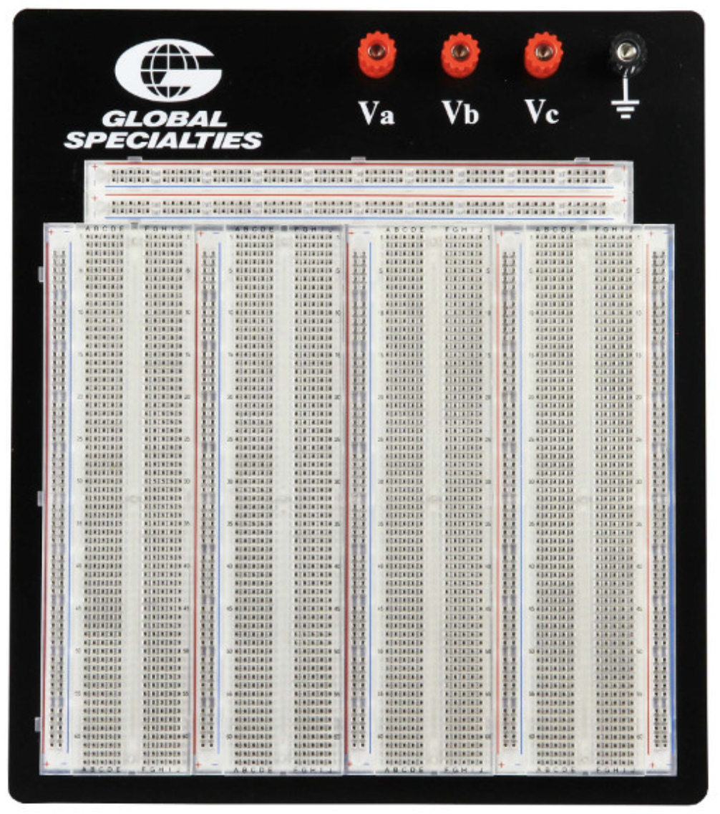
Get to know your protoboard.
Vertical connections
Horizontal connections
Gap

Slide 5
The input circuit is placed in the top left, and the output at the top right. The rest of the protoboard is used for design.
In
Out
Design

Slide 6
You must use a 5V power supply.
The setups we have in the lab are 5V, but we suggest splitting a USB for use outside of class instead of batteries.
D batteries are 9V, which could damage your LEDs.
In
Out
Design

Slide 7
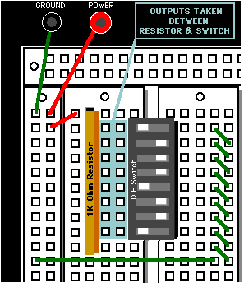
I/O Hardware: Input
You will be building the input circuit as shown on the right.
Note that the side which says “on” typically has the function of turning the line off, because when the switch is “on”, there is a path of no resistance to ground, so little to no current will travel through your wire.
More detailed information about the input hardware is available in the instructions.

Slide 8
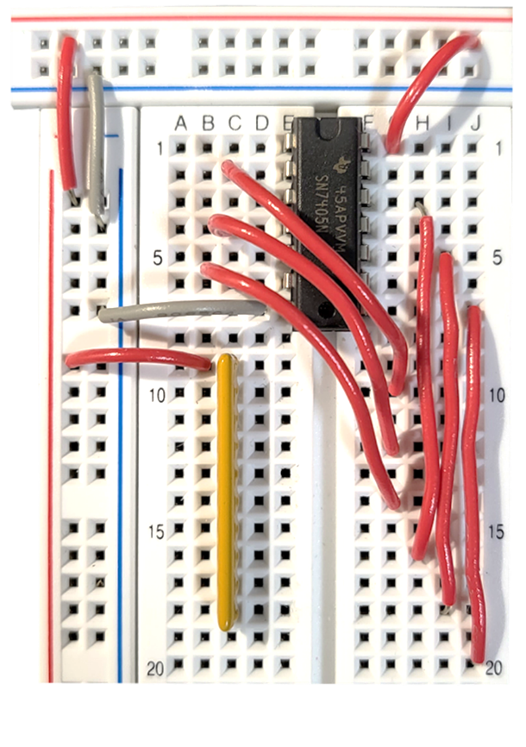
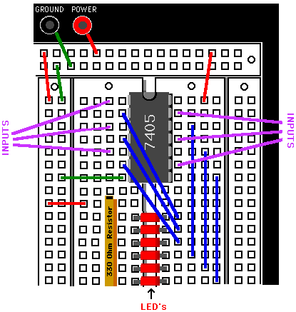
I/O Hardware: OUTput
You will be building the output circuit as shown here.
The 7405 chip has inputs and outputs as shown on the rightmost diagram. As you can see, these output lines are connected to the LEDs, and will stay there permanently.
The “results” of your designs for each lab will go to 7405 input pins.
More detailed information about the output hardware is available in the instructions.

Slide 9
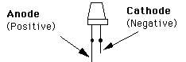
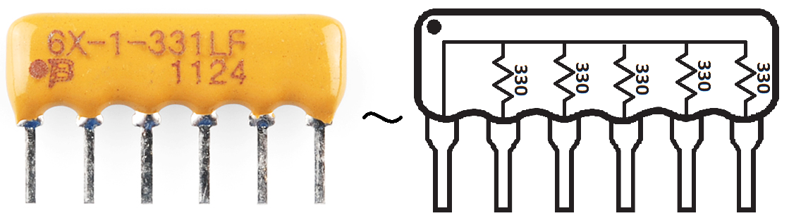
When placing the LEDs, make sure the anode (long leg) is facing the left (resistor side).
Please make sure the dot on the resistor is being connected to the power or ground

Slide 10
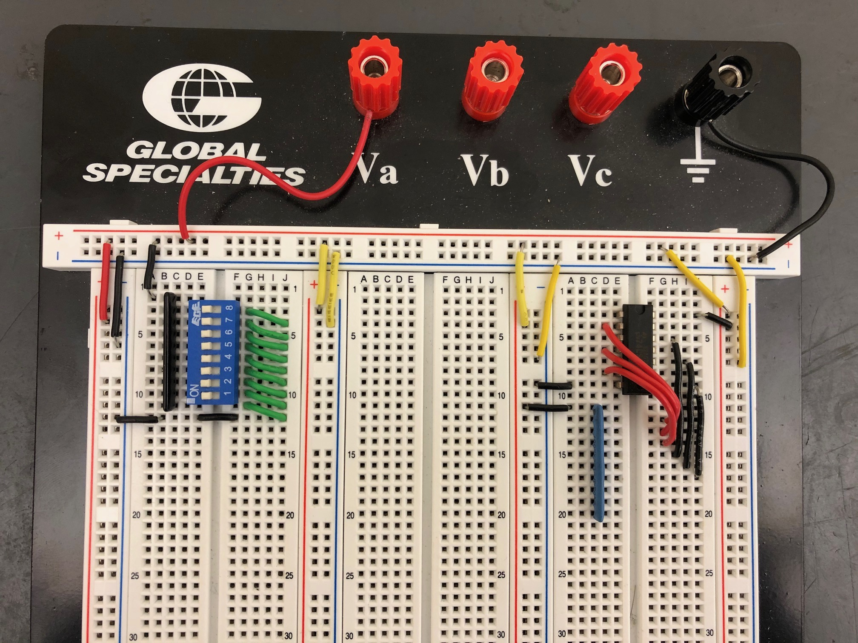
Your Task: Part 1
Build the circuit. Your final product should look exactly as shown (plus the LEDs). Colors don’t matter.
Be careful when stripping wires and handling chips. The legs are quite delicate, and do not respond well to bending. Use a straight edge if they do not fit into your protoboard.

Slide 11
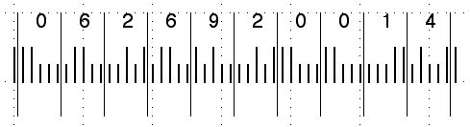
Introduction: POSTNET
The primary objective of this lab, besides the creation of the input/output hardware, if to build a circuit that can convert from a POSTNET value (used in postage codes) to XS3.
POSTNET is a 74210, 2-out-of-5 code. Long bars = 1, short bars = 0.

Slide 12
This segment represents 6, because…
7(0) + 4(1) + 2(1) + 1(0) + 0(0) = 6

Slide 13
This segment represents 2, because…
7(0) + 4(0) + 2(1) + 1(0) + 0(1) = 2

Slide 14
Zero is an anomaly.
7(1) + 4(1) + 2(0) + 1(0) + 0(0) = 11? = 0

Slide 15
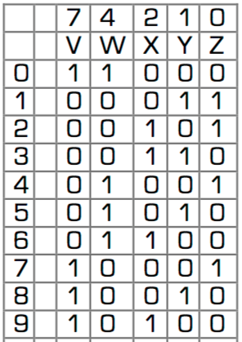
This is the table for all POSTNET values and the decimal equivalent. There are 5 input variables and thus 32 possible combinations. Note that we only use 10 of these…

Slide 16
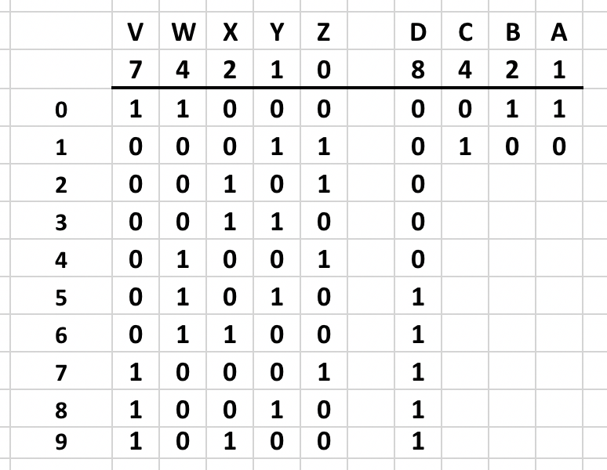
The table with all D values (in XS3) is shown. We need to create a formula for D, C, B, and A in order to logically convert to XS3.

Slide 17
We’ll start by mapping VWXYZ to a Karnaugh map for D.

Slide 18
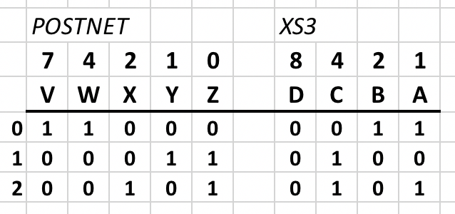
You will start this lab by creating a POSTNET to XS3 table.

Slide 19
Say we wanted to map the value for D when VWXYZ = 11000 to the K-map. That cell is highlighted in pink.
YZ
YZ
WX
00
01
11
10
WX
00
01
11
10
00
7
8
00
01
9
01
11
11
6
10
10
V
V’

Slide 20
The value for D at VWXYZ = 11000 is 0.
YZ
YZ
WX
00
01
11
10
WX
00
01
11
10
00
7
8
00
01
9
01
11
11
6
10
0
10
V
V’

Slide 21
Proceed for all POSTNET values 0-9.
YZ
YZ
WX
00
01
11
10
WX
00
01
11
10
00
1
1
00
0
01
1
01
0
0
11
11
1
10
0
10
0
1
V
V’

Slide 22
What about everything else? We don’t care, because we aren’t using codes that aren’t 2-out-of-5.
Don’t care states are X.
YZ
YZ
WX
00
01
11
10
WX
00
01
11
10
00
X
1
X
1
00
X
X
0
X
01
1
X
X
X
01
X
0
X
0
11
X
X
X
X
11
1
X
X
X
10
0
X
X
X
10
X
0
X
1
V
V’

Slide 23
Now we can minimize by drawing boxes.
Check Module 6 to see how you can draw boxes.
D = VW’ + WX + WY
YZ
YZ
WX
00
01
11
10
WX
00
01
11
10
00
X
1
X
1
00
X
X
0
X
01
1
X
X
X
01
X
0
X
0
11
X
X
X
X
11
1
X
X
X
10
0
X
X
X
10
X
0
X
1
V
V’

Slide 24
Conclusion: K-MAPS
YZ
YZ
Proceed for C, B, and A, then implement the design in LogicWorks. The equations are all called a “sum of products” as they are the sum of multiple minterms.
It may be helpful to number the cells with the 0-9 POSTNET values for the sake of quickly placing C, B, or A values.
WX
00
01
11
10
WX
00
01
11
10
00
7
8
00
1
01
9
01
2
3
11
11
6
10
0
10
4
5
V
V’

Slide 25

Other notes AND report information
When you are finished with the K-maps and the LogicWorks implementation of the equations (continue using only AND-2 and OR-2s), demo the functionality of the circuit. This concludes the lab for this week.
Hold off on jumping into hardware implementation until next week.
Again, both parts of this lab are individual submissions worth full points due to week after they are assigned.

